Slide 1
Making Twitter Bots
February 2018

Slide 2
What is a Twitter bot?
From Wikipedia:
A Twitter bot is a type of bot software that controls a Twitter account via the Twitter API.^{[1]} The bot software may autonomously perform actions such as tweeting, retweeting, liking, following, unfollowing, or direct messaging other accounts. The automation of Twitter accounts is governed by a set of automation rules that outline proper and improper uses of automation.^{[2]} Proper usage includes broadcasting helpful information, automatically generating interesting or creative content, and automatically replying to users via direct message.^{[3][4][5]} Improper usage includes circumventing API rate limits, violating user privacy, or spamming.^{[6]}

Slide 3
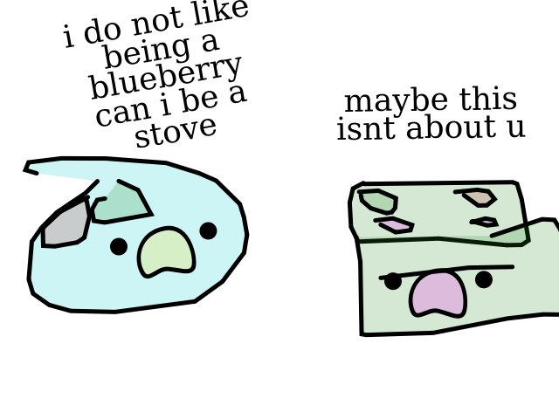
Bot or not?

Slide 4

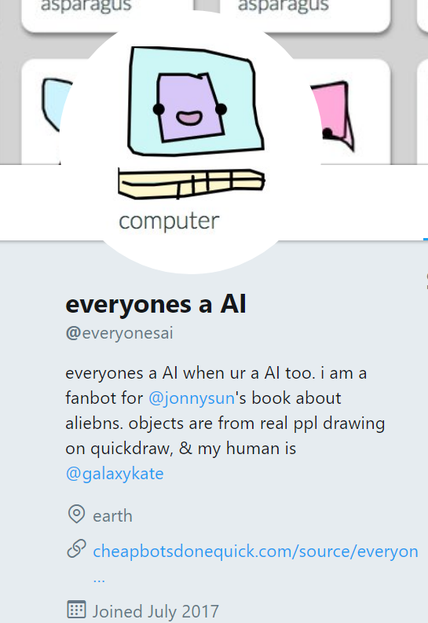
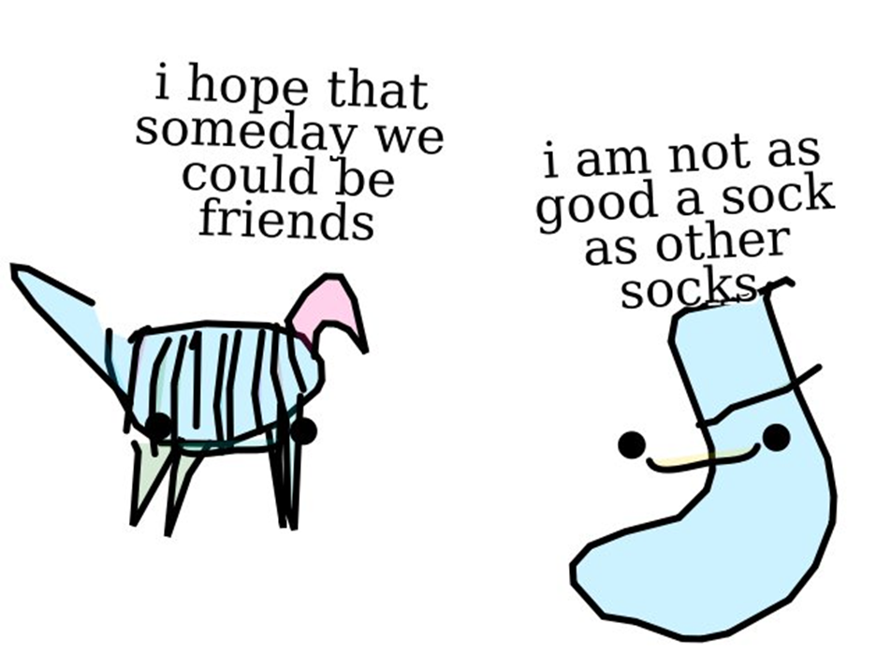
Bot!

Slide 5

Bot or not?

Slide 6
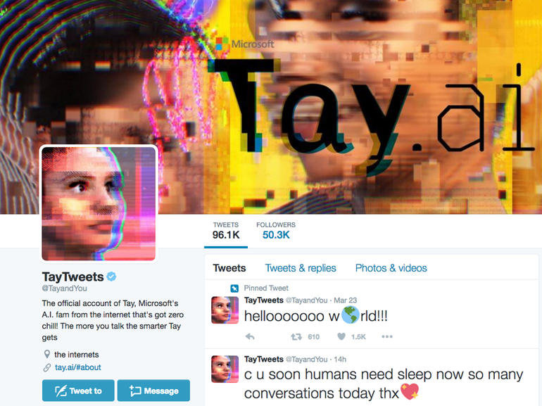
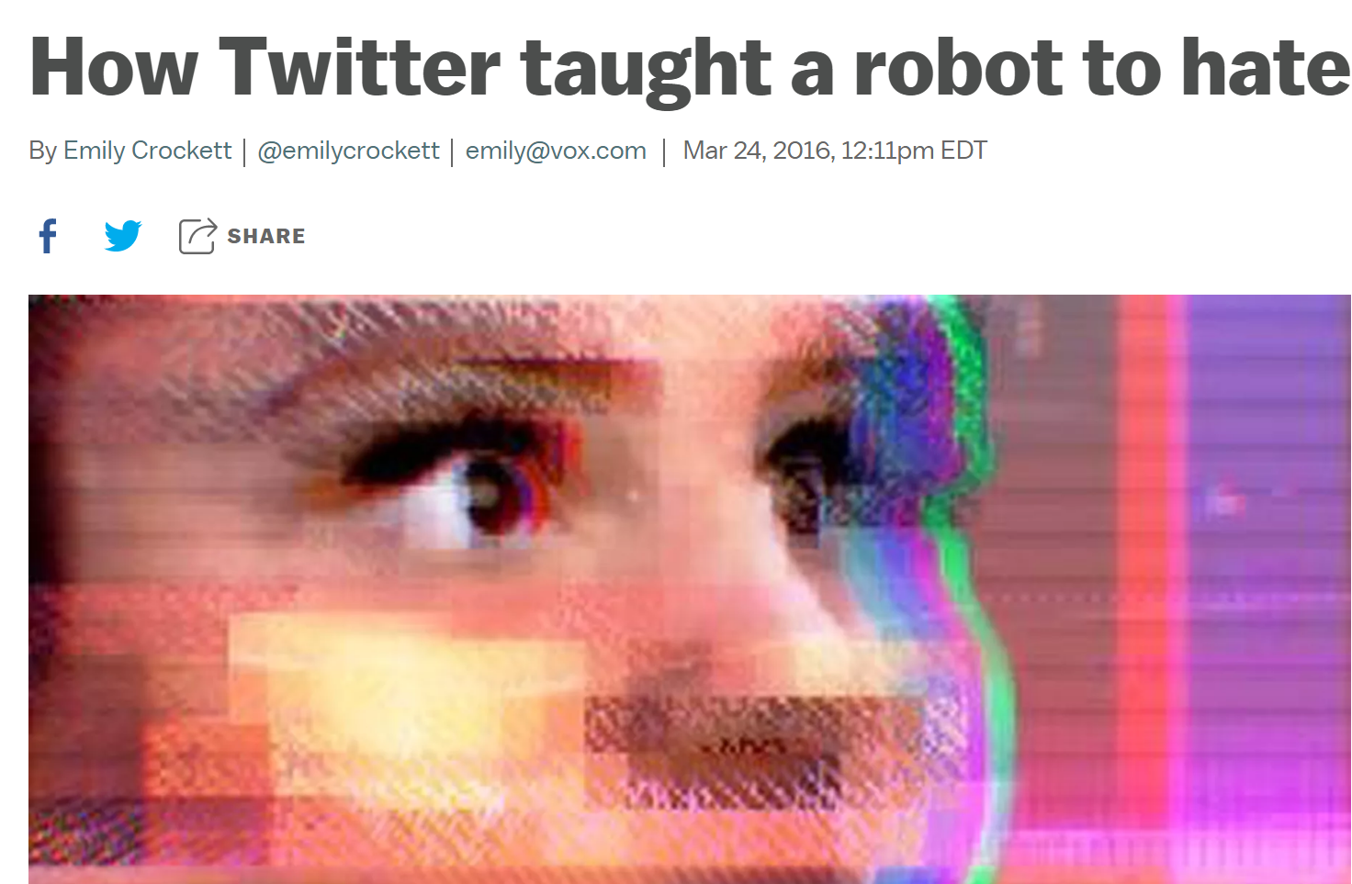
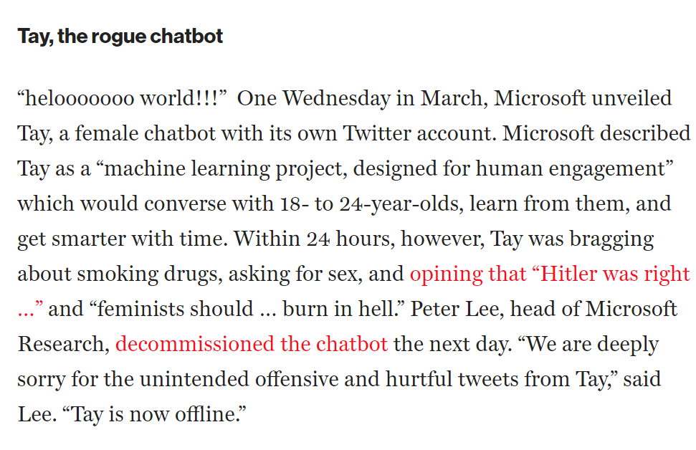
Bot!

Slide 7
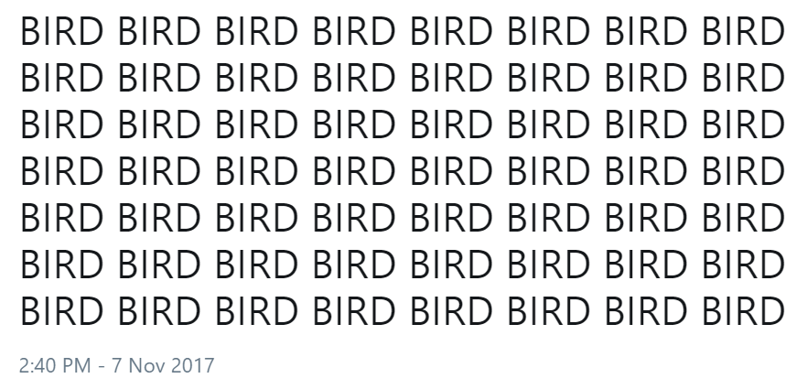
Bot or not?

Slide 8
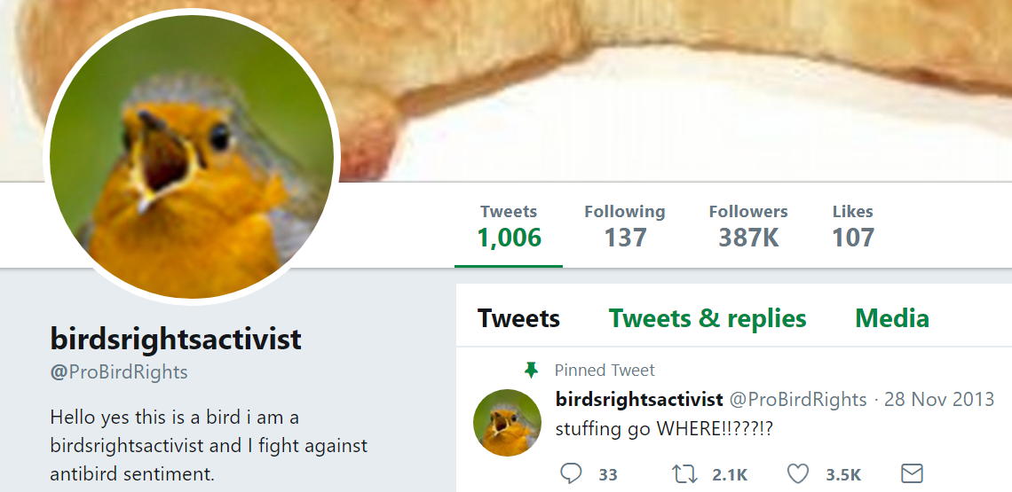
Not a bot ☺

Slide 9
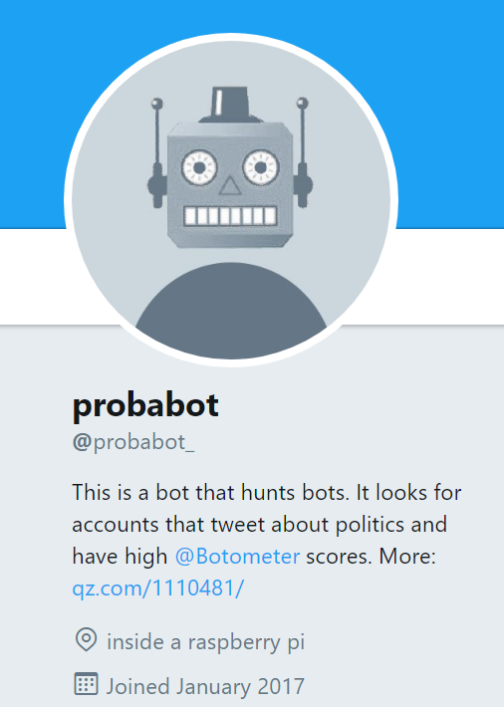
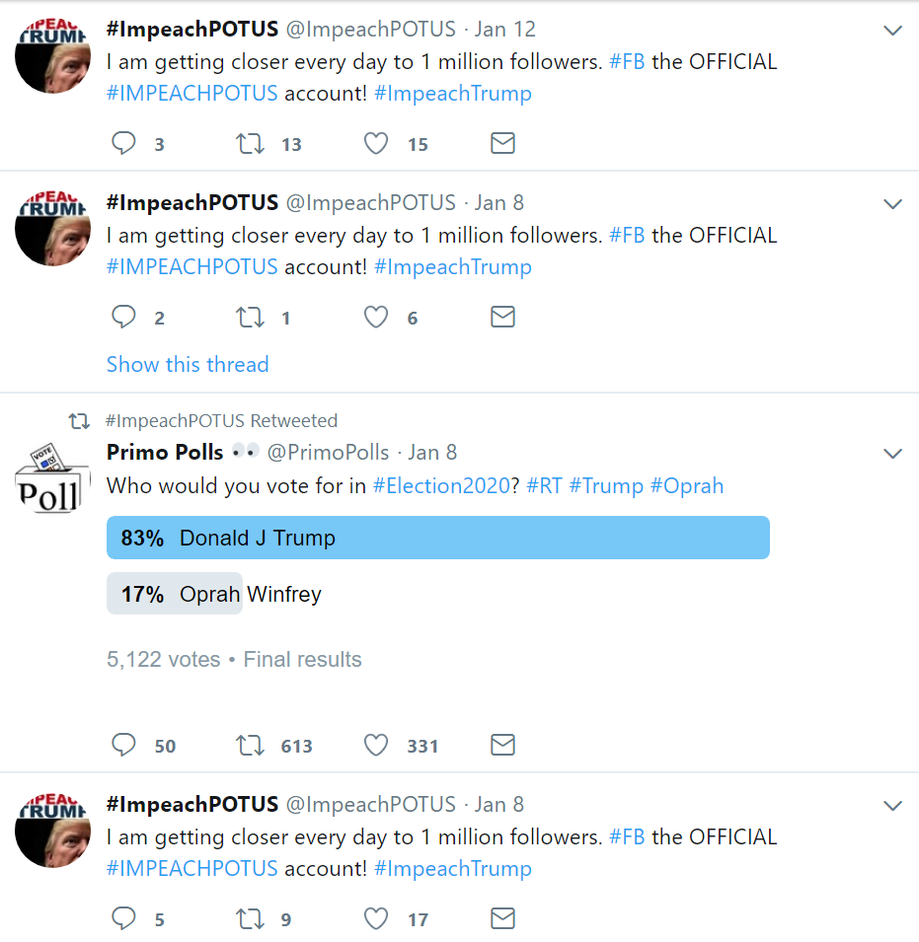
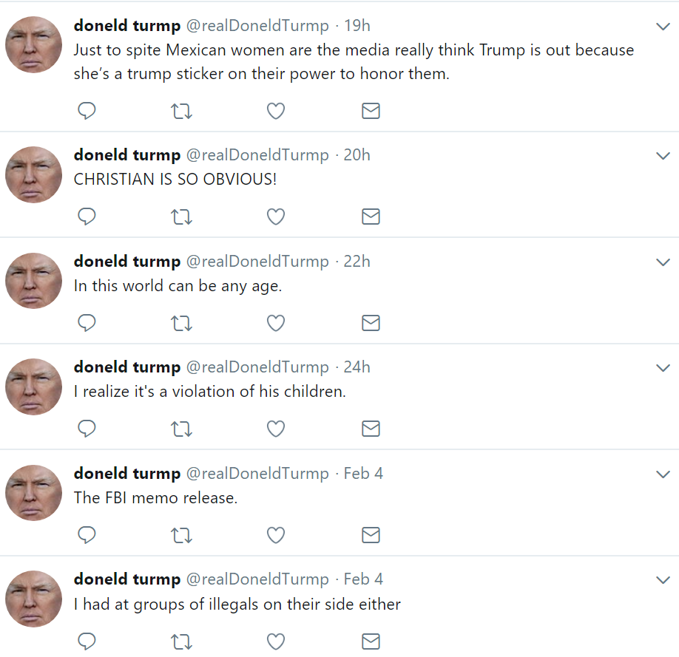
Some political bots

Slide 10
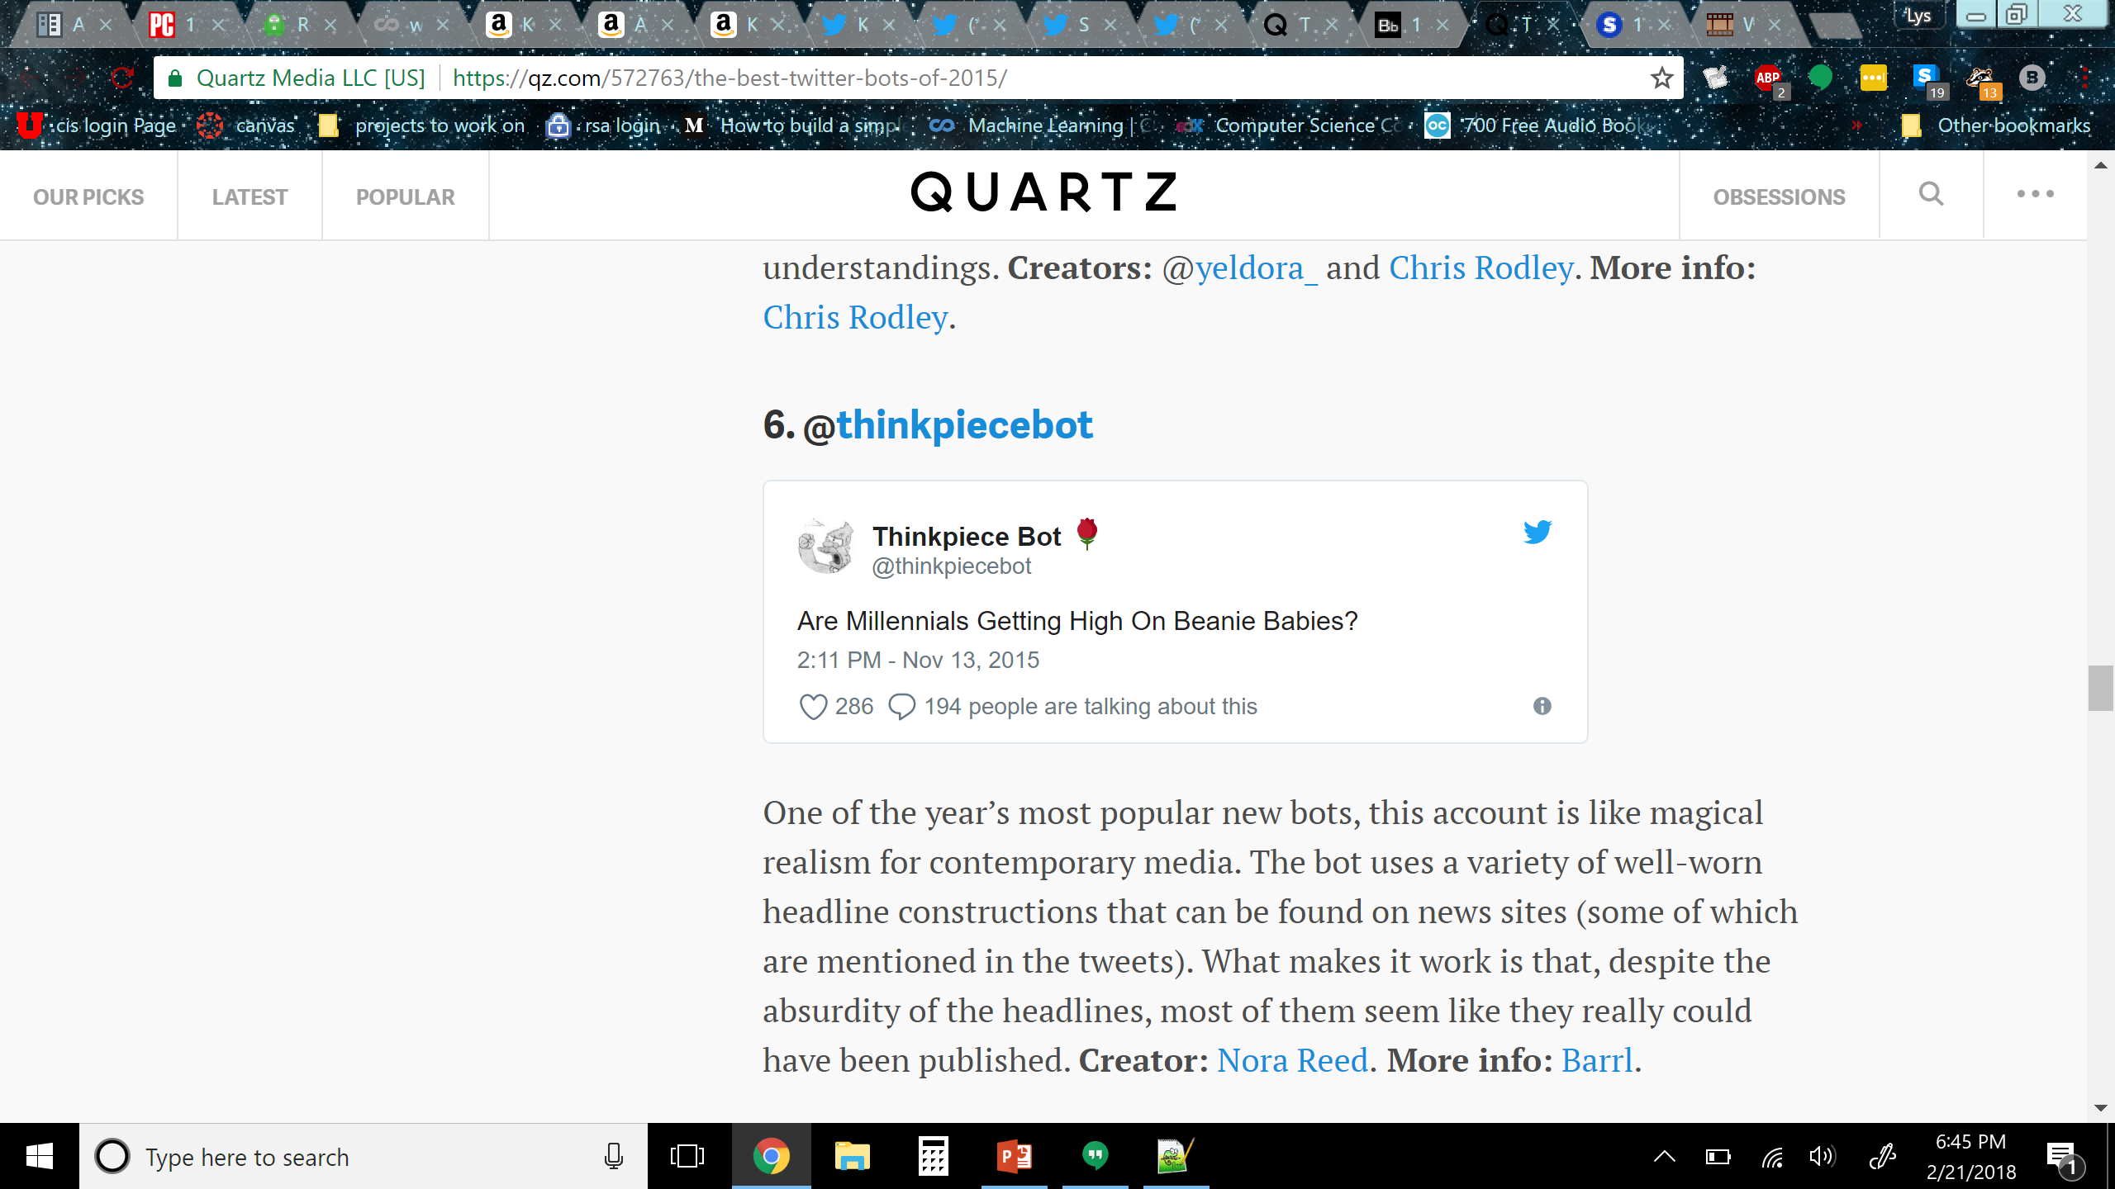
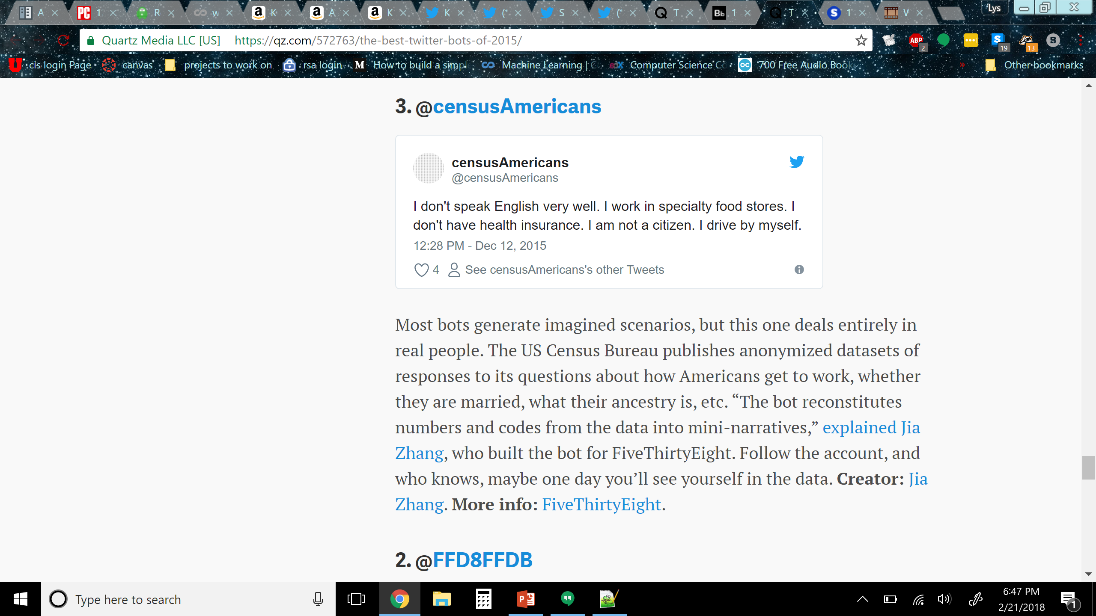
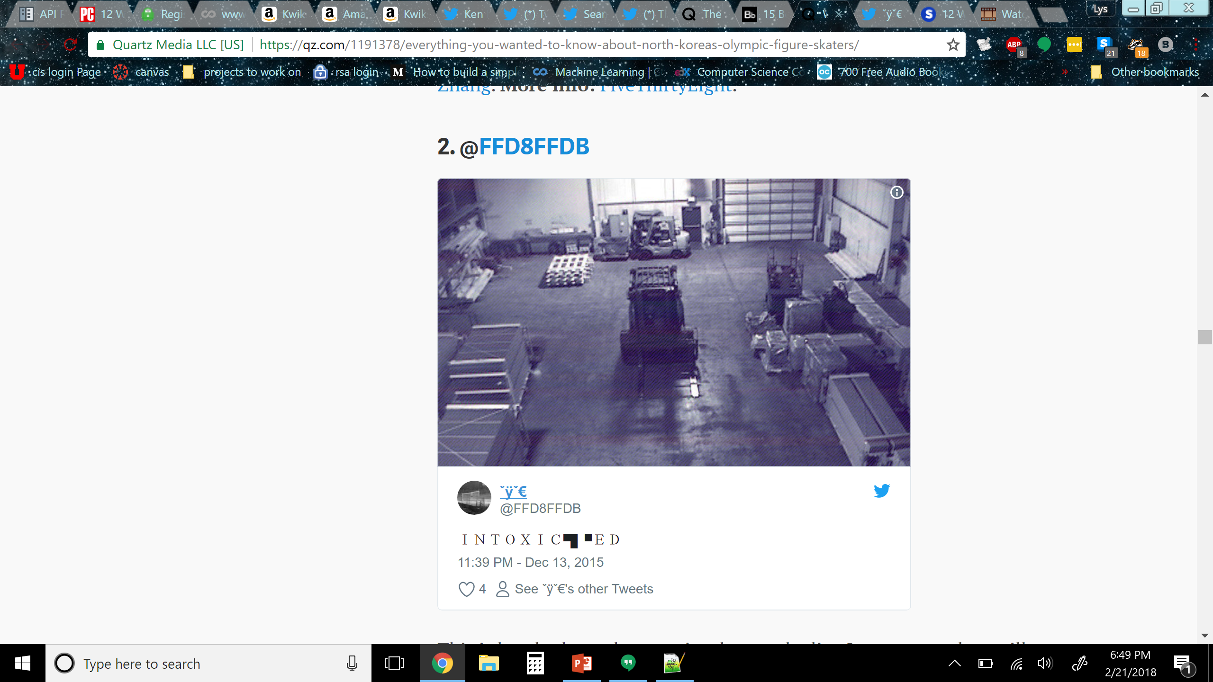

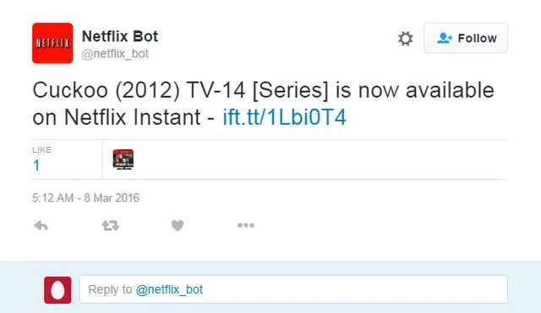
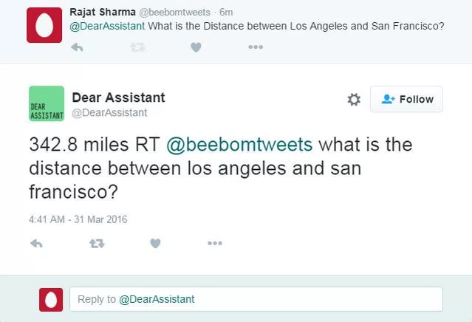
More interesting Twitter bots

Slide 11
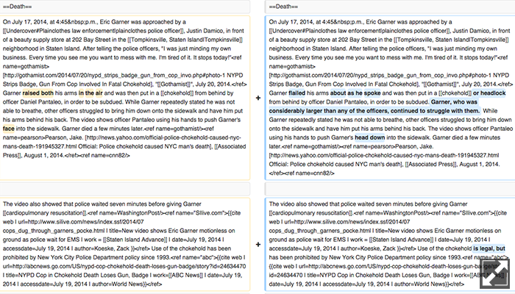
@NYPDEdits
The bot monitors Wikipedia in real time for anonymous edits from IP addresses registered to the New York City Police Department. The bot was inspired by an article by Kelly Weill in Capital New York exposing anonymous edits from NYPD IP addresses to Wikipedia pages containing details of alleged police brutality, NYPD scandals, and well-known victims of police altercations, including entries for Eric Garner, Sean Bell, and Amadou Diallo.

Slide 12
Getting started with Tweepy
tweepy.api — Twitter API wrapper
Timeline methods
Status methods
User methods
Direct Message Methods
Friendship Methods
Account Methods
Favorite Methods
Block Methods
Spam Reporting Methods
Saved Searches Methods
Help Methods
List Methods
Trends Methods
Geo Methods
Status methods
API.update_status(status[, in_reply_to_status_id][, lat][, long][, source][, place_id])
API.retweet(id)
Friendship Methods
API.create_friendship(id/screen_name/user_id[, follow])
Favorite Methods
API.create_favorite(id)

Slide 13
Use markovify to combine corpora
Another option: use NLTK

Slide 14
Make a compliment bot

Slide 15
Contest bot example

Slide 16
Account setup and credentials
#Input twitter API info from apps.twitter.com
CONSUMER_KEY = '' #keep the quotes, replace this with your consumer key
CONSUMER_SECRET = '' #keep the quotes, replace this with your consumer secret key
ACCESS_KEY = ''#keep the quotes, replace this with your access token
ACCESS_SECRET = '' #keep the quotes, replace this with your access token secret
auth = tweepy.OAuthHandler(CONSUMER_KEY, CONSUMER_SECRET)
auth.set_access_token(ACCESS_KEY, ACCESS_SECRET)
api = tweepy.API(auth)

Slide 17
Let’s make a bot!

Slide 18
Further resources
https://tweepy.readthedocs.io/en/v3.5.0/
https://github.com/jsvine/markovify
http://www.nltk.org/book/
https://www.gutenberg.org/ebooks/search/
https://gist.github.com/yanofsky/5436496

